Slide 1





Funding
Readiness Workshop

Slide 2

Outline
  Why don’t SMEs get funded
  Financial Health Check
  Business Life Cycle
  Sources of Funding and Funding landscape in South Africa
  Compliance
  Legal requirements
  Due Diligence
  Budgeting and forecasting
  Management Accounts

Slide 3






1
3
Business
2
Life Cycle
Why don’t SMEs get funded
& Funding
Options
Funding
Health
Check

Slide 4













Business Life Cycle
Phase 2:
Start Up
Phase 4:
Growth
Phase 1:
Ideation
Phase 3:
Early Stage
Phase 5:
Maturity

Slide 5
1
Compliance
Weak Business Model/ Plan
Customer Verification
Competitor Analysis
Industry Analysis (Sector Focus)
History
Affordability
Security
Financial Management
Why don’t SMEs get funded

Slide 6

4. Sources of Funding and Funding landscape in
South Africa

Slide 7



The Funder's Side
Why funders
fund
What’s in it for them
What attracts funders
Funders usually always have a mandate to fulfill; Black-owned businesses, women-owned businesses, tech-driven startups, or to try and make the world a better place.
Ultimately: returns. This can be through capital growth, dividends, or interest on debt.
Experience, stability and growth. Even start-ups in the launch can get equity funding if the entrepreneur has proven they can grow businesses. Ultimately, they are risk averse, funders want a sure bet.
Methods of funding
-Grants
-Equity
-Loans
-Mezzanine Finance

Slide 8



Types of Funders
Savings
Venture Capital
Friends, family
ESD funders
Development Funding Institutes
Commercial Funders
Specialist Funders

Slide 9

Types of Funding
Start-up Capital
Working Capital
Asset Purchases
Growth Funding
Debt Restructuring

Slide 10

5. Compliance

Slide 11

Non negotiables
  CIPC Annual Returns
  SARS (Income Tax, VAT, PAYE, UIF)
  BBBEE Affidavit
  Management Accounts
  Annual Financial Statements

Slide 12
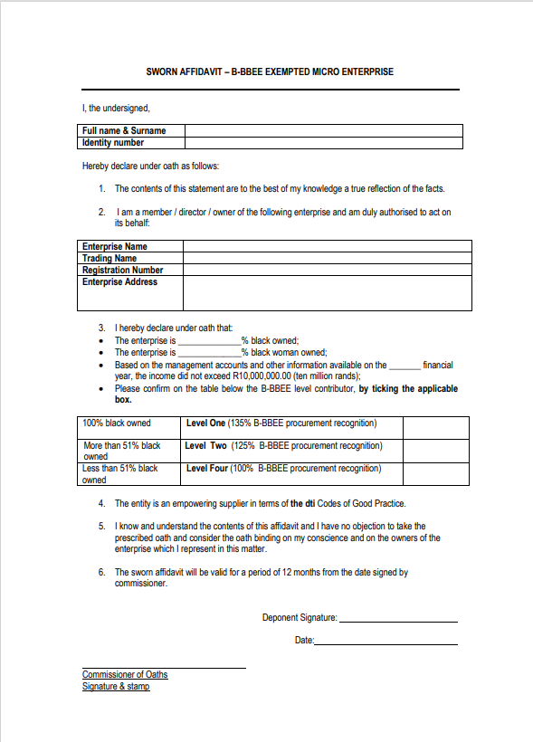
Example: BBBEE Affidavit

Slide 13
Management Accounts
Management accounts:
- Are financial reports produced for the business owners and managers,
generally monthly or quarterly.
- Normally a Profit & Loss report and a Balance Sheet.
They are similar to Year End accounts but are less formal and are personalized to the user’s requirements.
To enable management to take decisions on the performance,

Slide 14
Annual Financial Statements
The annual financial statements:
Are the comprehensive records of all the financial transactions of a business which is published every year for the purpose of providing information to the management and stakeholders.
Contents of the annual financial statements:
Income Statement
Balance Sheet
Cash Flow Statement
Statement of Retained Earnings

Slide 15

Relations Between Financial Statements
Income statement: Starts with revenues, then subtracts expenses to end with net income.
Statement of cash flows: Starts with net income, then adds back any non-cash expenses listed on the income statement, then accounts for sources or uses of cash which are shown as changes on the balance sheet to ultimately arrive at the net change in cash flow.
Balance sheet: Reports on a company's assets, liabilities, and shareholder equity at a specific point in time and provides a snapshot of what a company owns and owes, as well as the amount invested by shareholders.
Statement of retained earnings: Reports on the entity’s opening balance of retained earnings, dividend distributions, net income, and year-end balance of retained earnings at the end of the period,

Slide 16
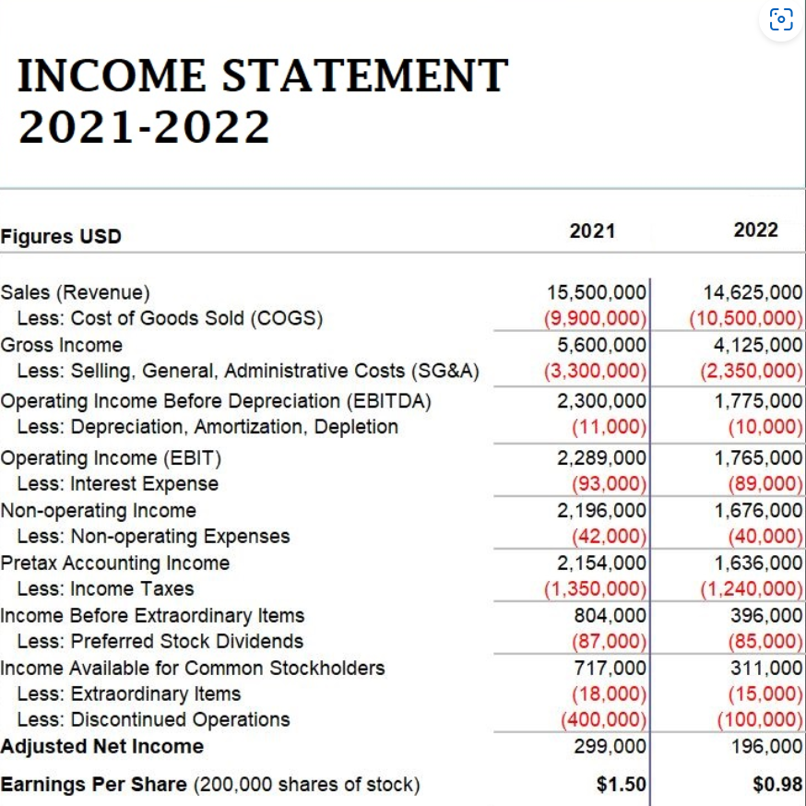
Example: Income Statement

Slide 17
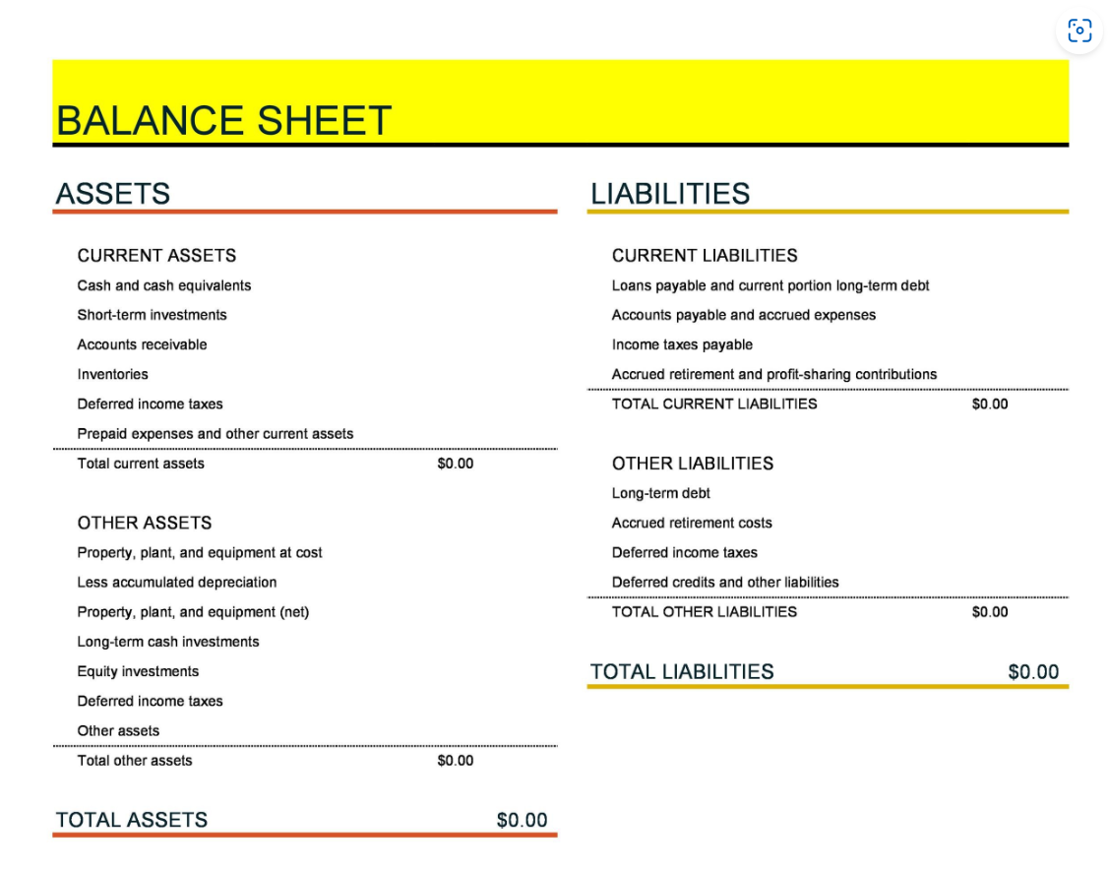
Example: Balance Sheet

Slide 18
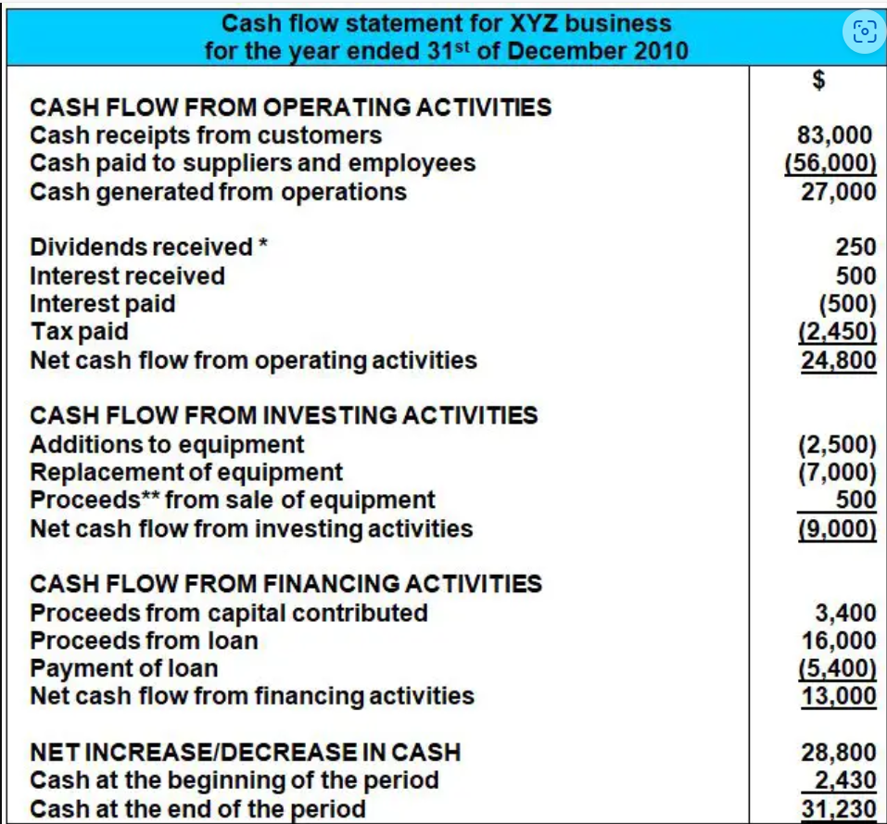
Example: Cash Flow Statement

Slide 19
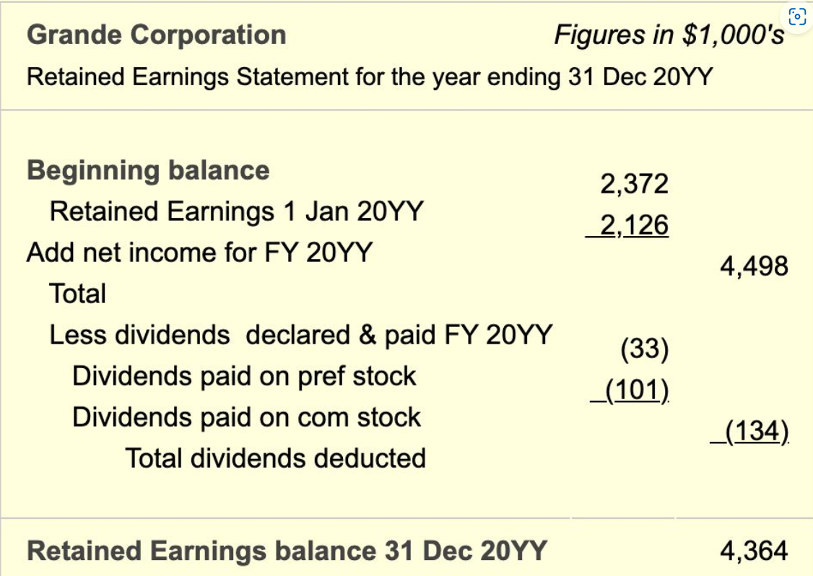
Example: Statement of Retained Earnings

Slide 20

6. Legal Requirements

Slide 21
Introduction to legal obligations
  Compliance and legal obligations are crucial for directors and shareholders of a private company as they ensure adherence to laws and regulations, minimizing the risk of legal penalties, reputational damage, and financial losses.
  Complying with legal obligations demonstrates good corporate governance, enhancing the company's credibility, attracting investors, and fostering a positive business environment.

Slide 22

Responsibilities and Duties of Directors
General Responsibilities of the Board of Directors:
  Oversight of control and accountability
  Development of strategy and performance objectives
  Systems of risk management and internal compliance and control
  Monitoring management's performance and implementation of strategies
  Approving and monitoring major capital expenditure, capital management, and acquisitions and divestments
  Approving and monitoring financial and other reporting
  Board appointments, removals, and succession planning.
Directors' Responsibilities under the Companies Act 2008:
Disclose any conflict of interest
Use their position and information for the company's benefit
Perform duties in good faith, in the best interest of the company, and with care, skill, and diligence
Comply with the Act and the company's memorandum of incorporation
Manage the business affairs of the company without trading recklessly or under insolvent conditions
Appoint board committees, audit committees, and a company secretary (in certain instances)
Call and convening shareholders’ meetings and directors' meetings
Keep company records and accounting records

Slide 23

Obligations of Shareholders
Attending meetings:
Shareholders are expected to attend general meetings of the company to participate in decision-making processes and stay informed about the company's affairs and performance.
Exercising voting rights:
Shareholders have the right to vote on significant matters affecting the company, such as electing directors or approving major corporate actions. They should actively exercise their voting rights to influence the company's direction. Voting rights are generally attached to the shares held by the shareholder, subject to any rights and restrictions specific to the class of shares
Complying with reporting requirements:
Shareholders are obligated to comply with reporting obligations, which may include disclosing their shareholdings and interests in the company. These reporting requirements are typically governed by the Companies Act of South Africa and any rules specified in the company's Memorandum of Incorporation (MOI) or other governing documents.

Slide 24
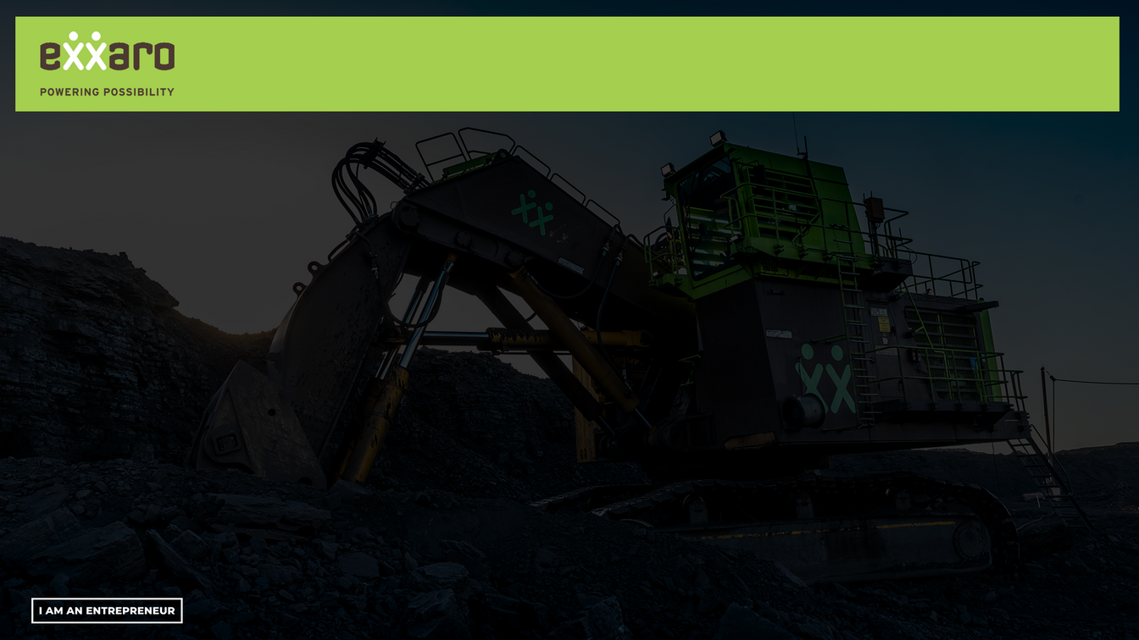

Understanding Legally binding contracts
In the context of South African contract law, a legally binding contract is formed when the following essential elements are present:
Offer: An offer is a specific and definite proposal made by one party to another, expressing an intention to enter into a legal agreement.
Acceptance: The agreement by the other party to the terms of the offer. It must mirror the terms of the offer and be communicated to the offeror.
Meeting of the Minds: There must be an agreement between the parties regarding the terms of the contract, including the scope, obligations, and benefits of the agreement.
Consideration: Consideration refers to something of value exchanged between the parties. It can be a promise, an act, or a forbearance. Consideration must have legal and sufficient value and is necessary to create a binding contract.
Capacity: The parties entering into the contract must have the legal capacity to do so. They must be of sound mind and not be minors or individuals with limited capacity.
Legality: The contract's purpose and the activities involved must be legal and not prohibited by law.

Slide 25

Walkthrough of a Typical Financing Loan Agreement
Components
Clauses
Additional
Considerations
Loan Amount and Purpose: The agreement specifies the amount of the loan and the intended purpose for which the funds will be used.
Interest Rate: It outlines the interest rate at which the loan will be charged, which determines the cost of borrowing for the borrower.
Repayment Terms: This section details the repayment schedule, including the frequency of payments, the duration of the loan, and any specific terms regarding early repayment or prepayment penalties.
Security: If applicable, the agreement may require the borrower to give security to secure the loan. This can include assets such as property, equipment, or inventory, which can be seized by the lender in case of default.
Events of Default: The agreement defines the events or conditions that would constitute a default by the borrower, such as failure to make timely payments, breach of other obligations, or financial distress. It specifies the consequences of default, which may include penalties, acceleration of the loan, or legal action.
Representations and Warranties: The borrower typically makes certain representations and warranties about its legal and financial standing, ensuring that the information provided is accurate and complete.
Covenants: The agreement may include covenants, which are specific obligations or restrictions that the borrower must comply with during the term of the loan. These can include financial reporting requirements, limitations on additional borrowing, or restrictions on business activities.
Governing Law and Jurisdiction: The agreement specifies the governing law (South African law in most of your cases) and the jurisdiction in which any disputes arising from the agreement will be resolved.

Slide 26

Understanding the Fine Print
It is crucial to emphasize the significance of reading and understanding the fine print. Failure to do so may lead to unexpected consequences and disputes.
Common clauses found in financing loan agreements in South Africa include:
Interest Rates: Loan agreements specify the rate at which interest will be charged on the borrowed amount, which affects the overall cost of borrowing.
Repayment Terms: These outline the schedule, frequency, and amount of loan repayments, including any grace periods or early repayment options.
Collateral: Loan agreements often require borrowers to provide collateral, such as property or assets, to secure the loan and mitigate the lender's risk.
Default Provisions: These clauses define the circumstances under which a borrower is considered in default, such as missing payments or breaching other contractual obligations.
Consequences of Non-Compliance: Loan agreements outline the potential consequences of non-compliance, such as penalties, increased interest rates, or legal actions by the lender.

Slide 27
Evaluating Terms of a Loan Agreement
To interpret and evaluate the terms and conditions of a loan agreement, follow these guidelines to ensure clarity and mitigate risks:
Read Carefully: Thoroughly review the entire agreement, paying close attention to the fine print, definitions, and obligations of both parties.
Seek Legal Advice: Consider consulting a legal professional familiar with contract law in South Africa to provide guidance and ensure you fully understand the implications of the agreement.
Assess Interest Rates: Evaluate the interest rate and understand its impact on the total repayment amount to determine affordability and compare with prevailing market rates.
Scrutinize Repayment Terms: Examine the repayment schedule, including the frequency, duration, and any associated fees or penalties to ensure it aligns with your financial capabilities.
Understand Collateral Requirements: Assess the collateral requested by the lender and evaluate the potential risks involved, considering the value and ownership implications.
Review Default Provisions: Pay attention to the circumstances that constitute default and the repercussions, such as additional charges, accelerated repayments, or the lender's right to take legal action.
Clarify Consequences of Non-Compliance: Understand the specific consequences and penalties for non-compliance with the agreement, ensuring they are reasonable.
Seek Clarification: If any terms or clauses are unclear, request clarification from the lender or engage in negotiations to modify or remove ambiguous or unfavorable terms.

Slide 28

Practical Advice for Entrepreneurs
When entering into a legally binding agreement, entrepreneurs in South Africa have the following responsibilities and implications:
Compliance with tender specifications and conditions: Entrepreneurs participating in public procurement processes must ensure their bids conform to the specifications and conditions laid out in the tender invitation. Failure to comply may result in disqualification from the tender process and exclusion from lucrative opportunities.
Financial penalties: Non-compliance with contractual obligations can lead to financial penalties imposed by the other party. Entrepreneurs should fulfill their obligations to avoid such penalties, which can have a negative impact on the company's financial position.
Legal actions: If entrepreneurs fail to comply with the terms of the agreement, the other party may initiate legal actions to seek remedies, such as specific performance or damages. Entrepreneurs should be aware of the potential legal consequences and strive to fulfill their obligations to avoid litigation
Damage to company's reputation: Non-compliance with contractual agreements can harm the company's reputation. Public exposure of such non-compliance can lead to reputational damage, loss of customer trust, and missed business opportunities. Entrepreneurs should prioritize compliance to maintain a positive public image.

Slide 29
Legal Requirements for Taking on Debt
Thoroughly review and understand the terms and conditions of the agreement:
Entrepreneurs should carefully read and comprehend the agreement before entering into it. Seeking legal advice can help ensure a clear understanding of their obligations and potential risks.
Comply with contractual obligations:
Entrepreneurs must make diligent efforts to fulfill all contractual obligations within the agreed-upon timelines and quality standards. This includes delivering goods or services as specified, meeting performance targets, and adhering to any other requirements outlined in the agreement.
Maintain accurate documentation and seek legal advice when necessary:
Keeping records of all communications, transactions, and actions related to the agreement is crucial. This documentation can serve as evidence of compliance and protect entrepreneurs in case of disputes or legal actions. Entrepreneurs should consult with legal professionals experienced in contract law to ensure their rights are protected and to mitigate legal risks.

Slide 30
7. Due Diligence

Slide 31




Why use a Due Diligence Data Room
1
2
3
Saves Time
Increased Transparency
Secure Access
By having your important documents all in one place, investors can easily access what the need
The data room makes it incredibly easy for
Control who is accessing your confidential information

Slide 32
8. Budgeting and Forecasting

Slide 33


Budgeting
1
2
Budgeting
Financial Forecasting
A budget is a quantitative visualisation of a proposed future plan for a specific period. It may include Financial and nonfinancial information.
A financial forecast is an estimate of future financial outcomes for a business, applied in budgeting, capital budgeting and/ or valuation.

Slide 34
Budgeting
Definition: A budget is a quantitative visualization of a proposed future plan for a specific period. It may include Financial and nonfinancial information.
Planning is the design of a desired future and of the effective ways of bringing it about
Strategic Planning: purposely controlling future operations towards desired objectives for periods longer than one year
Short-term Planning: Given the current business scenario, uses the budget as a tool to create a forecast for the next twelve months
The core of financial management is the decisions that are required to ensure growth of the business enterprise and the funds invested.
Budgeting is a tool used by management to make more informed decisions and to plan for the ahead and monitor performance.

Slide 35
Importance and Advantages of Budgeting
Financial Control: Budgeting provides a clear picture of income and expenses, allowing one to exercise better control over their finances. This allows one to identify areas where they are overspending or where they can cut back, helping to stay within set financial means.
Goal Setting & Planning: A budget helps one set financial goals and provides a roadmap for achieving them. Whether it's saving for a down payment or paying off debt, budgeting allows one to allocate funds toward their goals systematically.
Debt Management: Budgeting plays a vital role in managing and reducing debt. By allocating a portion of one’s budget towards debt repayment, one can systematically pay off outstanding balances, reduce interest charges, and work towards becoming debt-free.
Improved Decision Making: A budget provides one with a clear overview of a financial situation, enabling them to make informed decisions. When faced with choices about major purchases or investments, one can consult their budget to determine if they have the financial resources available.

Slide 36

Useful Purposes of Budgeting
Controlling Activities
Evaluate the Performance of Managers
Planning Annual Operations
Motivating Managers to Achieve Goals
Having a budget enables managers to control the business. The stages in budgetary control are:
Preparation of plans
Comparison of plans with actual results
Analysis of variances (actual vs. budget).
Large variance = drill down and resolve inefficiencies
Major planning decisions taken:
Sales Price increase
New staff
New division expansion
Update budget to reflect decisions above. Above decision implementation is refined in budget to anticipate problems.
Incentive to influence the behavior of managers
A standard that manager may be motivated to strive to achieve/hold accountable towards
Managers to assist with budget set-up
Department and Manager performance should be evaluated by measuring success in meeting budgets.
This could influence annual bonuses and/or pay increase.
Additionally, this will affect human behavior.

Slide 37

Financial Forecasting
1
2
Budgeting
Financial Forecasting
A budget is a quantitative visualisation of a proposed future plan for a specific period. It may include Financial and nonfinancial information.
A financial forecast is an estimate of future financial outcomes for a business, applied in budgeting, capital budgeting and/ or valuation.

Slide 38
Financial Forecasting
Definition: It is an estimate of future financial outcomes for a business, applied in budgeting, capital budgeting and/ or valuation.
1
Budgeting
It refers to financial projections performed to facilitate any decision-making relevant for determining future business performance.
The process includes the analysis of past business performance, current business trends, and other relevant factors.
2
Common Types of Financial Forecasting
Sales Forecasting
Cash Flow Forecasting
Budget Forecasting
Income Forecasting

Slide 39
Forecasting Methods
Quantitative
Qualitative
Based on actual figures of past years that are expected to be repeated
Based on figures that can be substantiated
Judgmental
Based on professional sense or experience
Expert
Based on the opinion of an expert in the particular field
Consensus
Based on collective opinion, for example management discussion

Slide 40

Cash Flow Forecasting
Cash Flow Analysis
Involves examining of the major components of a business that affect cash flows.
Inflows: Debtors received from various streams, loan received, government grants, equity investment.
Outflows: Inventory and equipment purchase, payment of general expenses, employee costs.
Performing a cash flow analysis allows cash flow problems to be identified and find ways to improve cash flow.
Cash Flow Forecasting
The result of a cash flow forecast is a cash flow report that details how much money you expect to take in and spend over a given period of time and an estimated bank balance at the end of each covered period.
The objective is to determine shortages or excess of cash necessary to operate the business.
With the Cash Flow Forecasting tool, you can develop a plan that will provide well managed cash flow.
Forecast Formulas
Free Cash Flow = Net income + Depreciation/Amortization – Change in Working Capital – Capital Expenditure
Operating Cash Flow = Operating Income + Depreciation – Taxes + Change in Working Capital
Cash Flow Forecast = Beginning Cash + Projected Inflows – Projected Outflows = Ending Cash

Slide 41
Importance and Advantages of a Cash Flow Forecast
Importance
Advantages
Accurate cash flow projection allows companies to estimate their future financial balances, avoid catastrophic cash shortages, and maximize the return on any cash surpluses.
Develop an understanding of available funding
Evaluate financial risk
Assess the likelihood of sustainable services
Identify future commitments and resource demands
Identify key variables that cause material changes in the levels of cash in- and outflow
Project credit requirements and repayment plan
Communicate this plan to lender
Consideration of taking an equity partner on board
Analysis of the amount of time the above funds can last the burn
Monitoring actual cash flows throughout the year.
Financial decision-making process
Plan marketings patterns and other spending habits

Slide 42

Cash Flow Forecasting
Assumptions
Realistic.
Evidence-based - especially when outside of industry norms.
Consistently applied.
Cash Flow Forecasts do not include:
Depreciation.
Change in valuations.
Opportunity cost.
Non-cash Revenue.
Any other non-cash items.
Timing
Monthly/Quarterly/Annually
It is advised that an annual forecast to be broken down into months.

Slide 43
9. Management Accounts

Slide 44
Relations Between Financial Statements
Income statement: Starts with revenues, then subtracts expenses to end with net income.
Statement of cash flows: Starts with net income, then adds back any non-cash expenses listed on the income statement, then accounts for sources or uses of cash which are shown as changes on the balance sheet to ultimately arrive at the net change in cash flow.
Balance sheet: Reports a company's assets, liabilities, and shareholder equity at a specific point in time and provides a snapshot of what a company owns and owes, as well as the amount invested by shareholders.
Statement of retained earnings: Reports on the entity’s opening balance of retained earnings, dividend distributions, net income, and year-end balance of retained earnings at the end of the period,

Slide 45

Thank You

